Slide 1
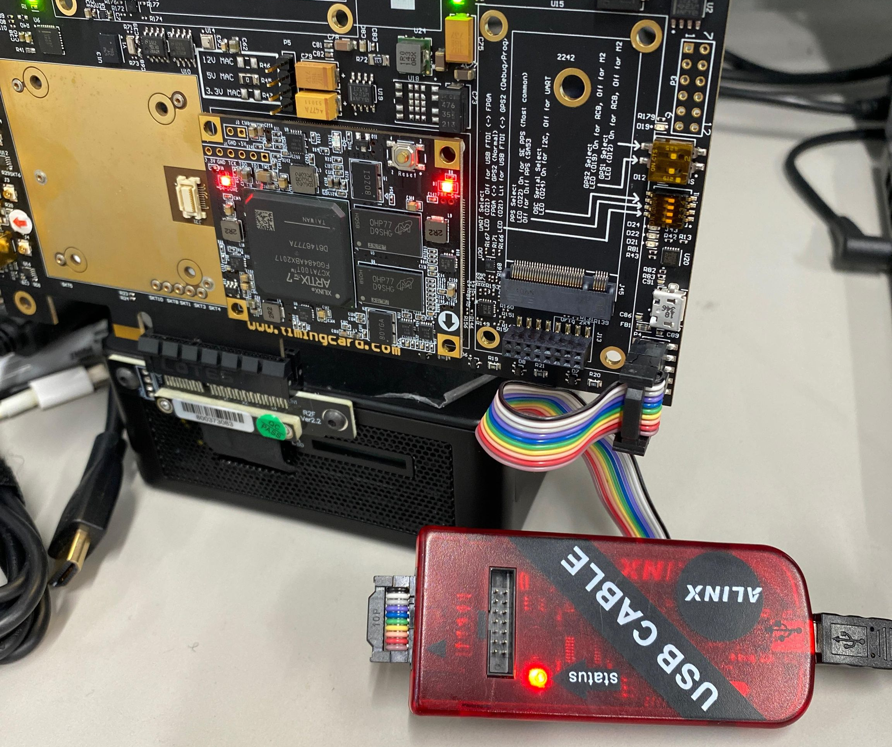
1. Соединить через JTAG Qantum Card

Slide 2
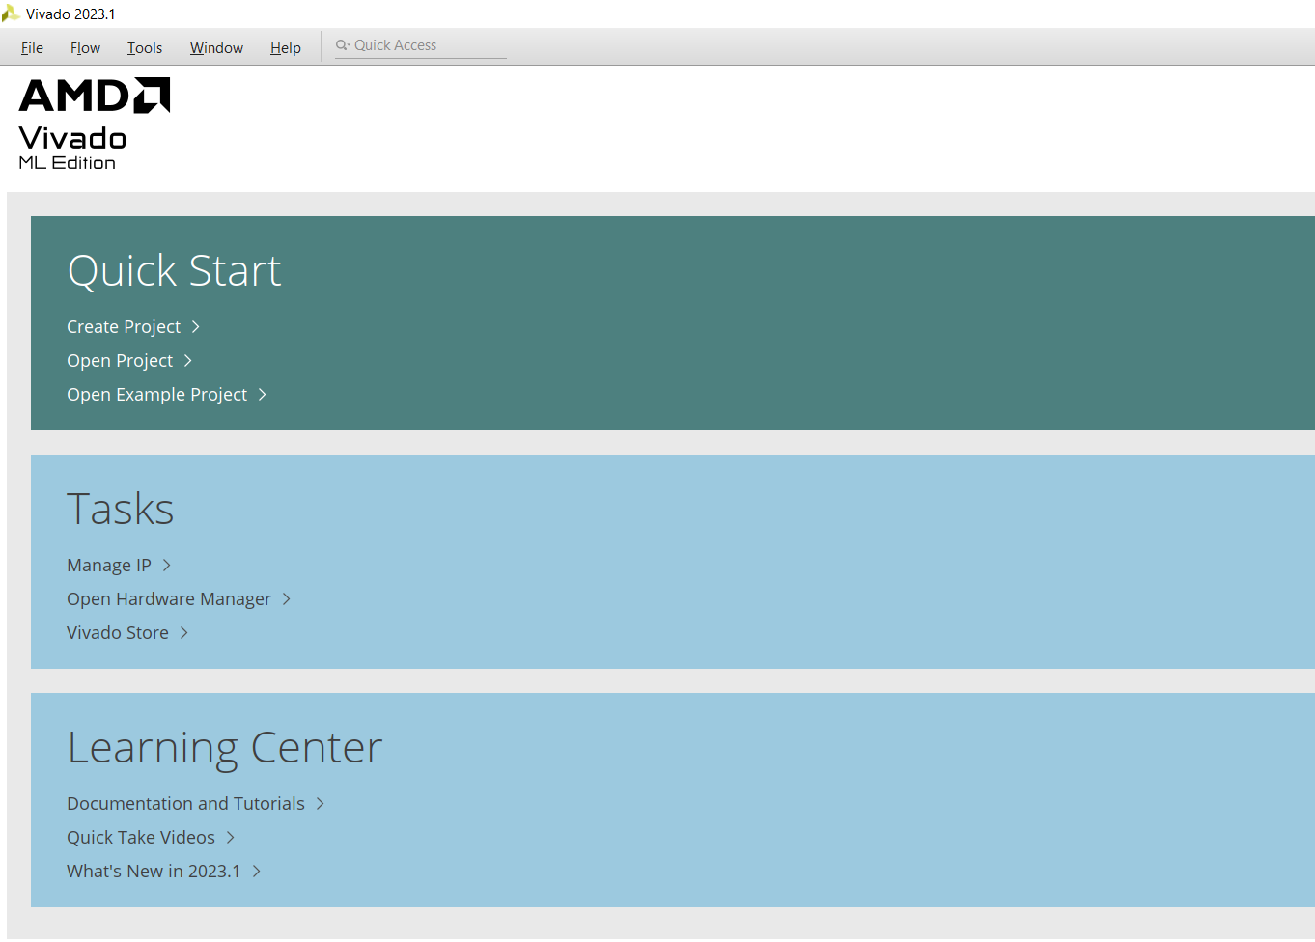
Открыть Vivado

Slide 3
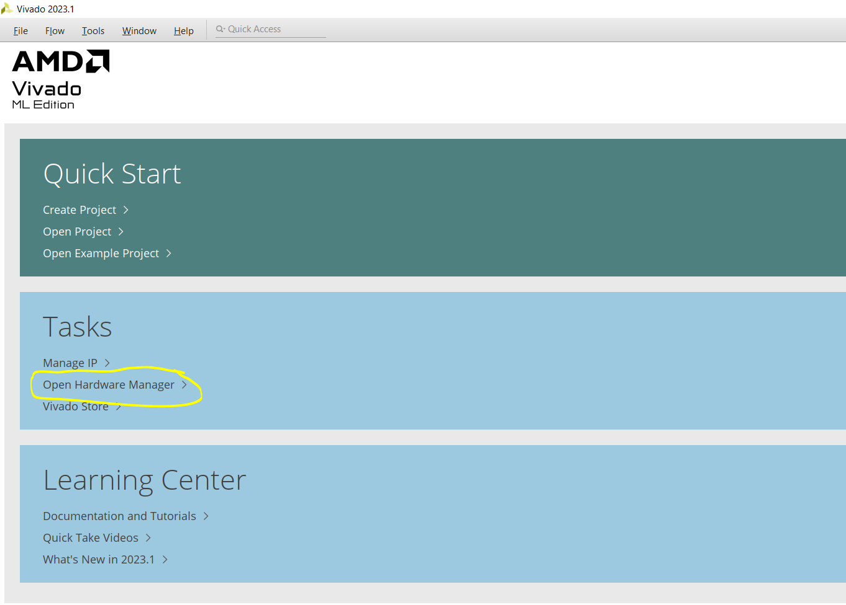
Открыть Hardware manager

Slide 4
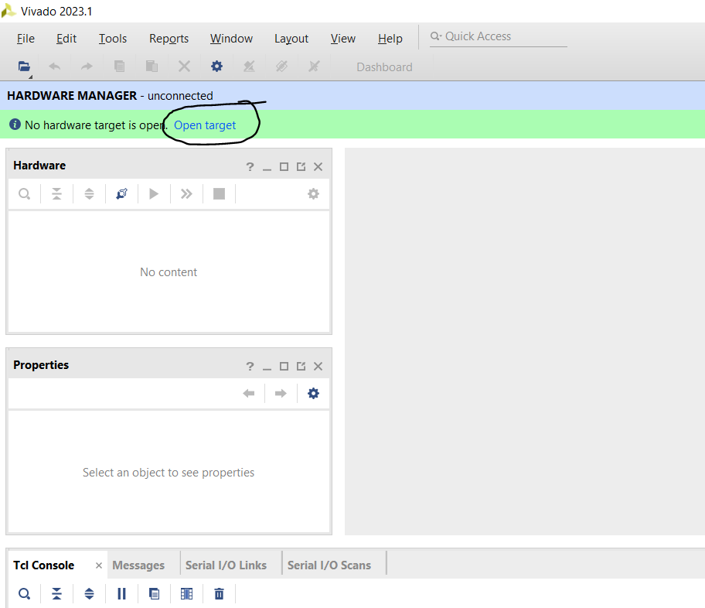
Открыть Open Target -> Auto Connect

Slide 5
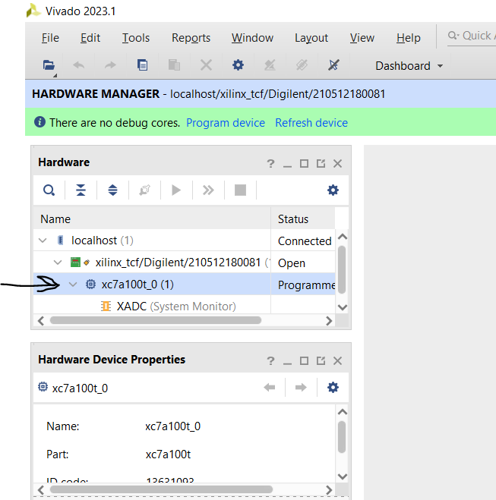
Right click on xc7a100t_0, click Add Configuration Memory Device

Slide 6
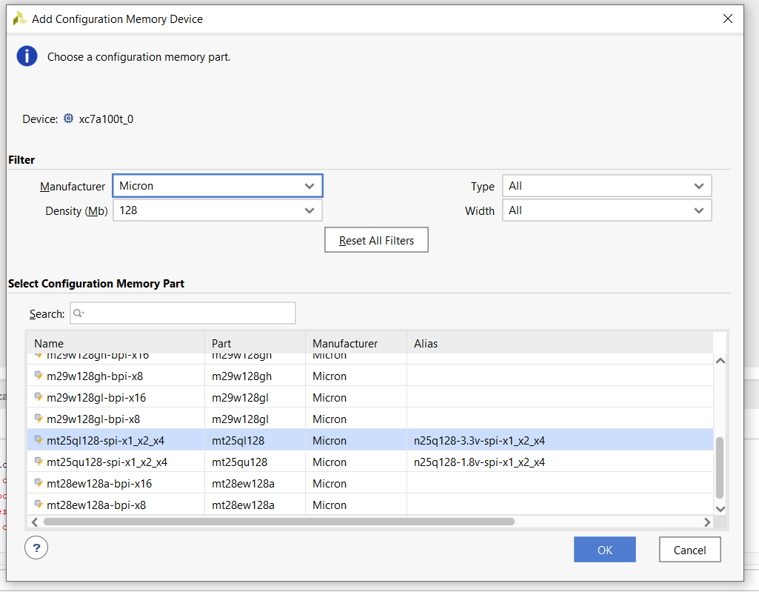
Find and select this memory device

Slide 7
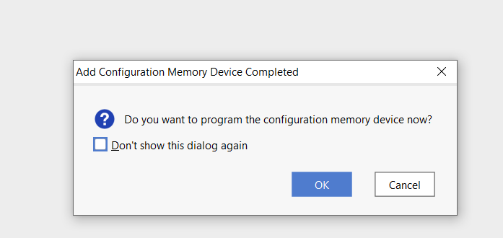
When this pops up, press OK

Slide 8
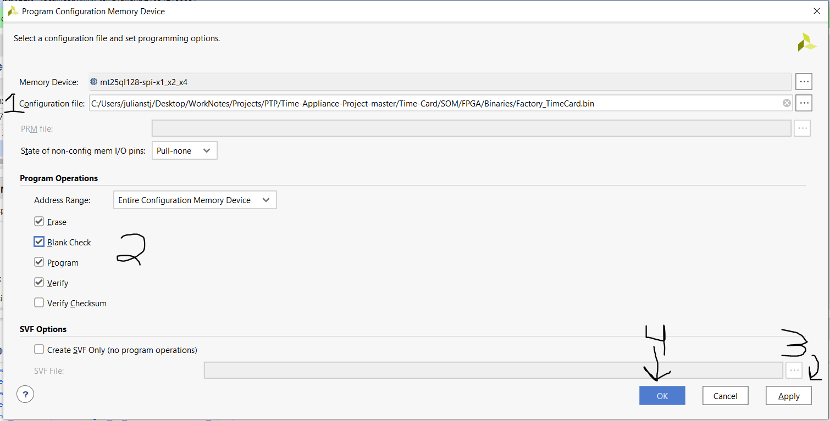
Select the programming file, then select these options, then hit Apply , then hit ok

Slide 9
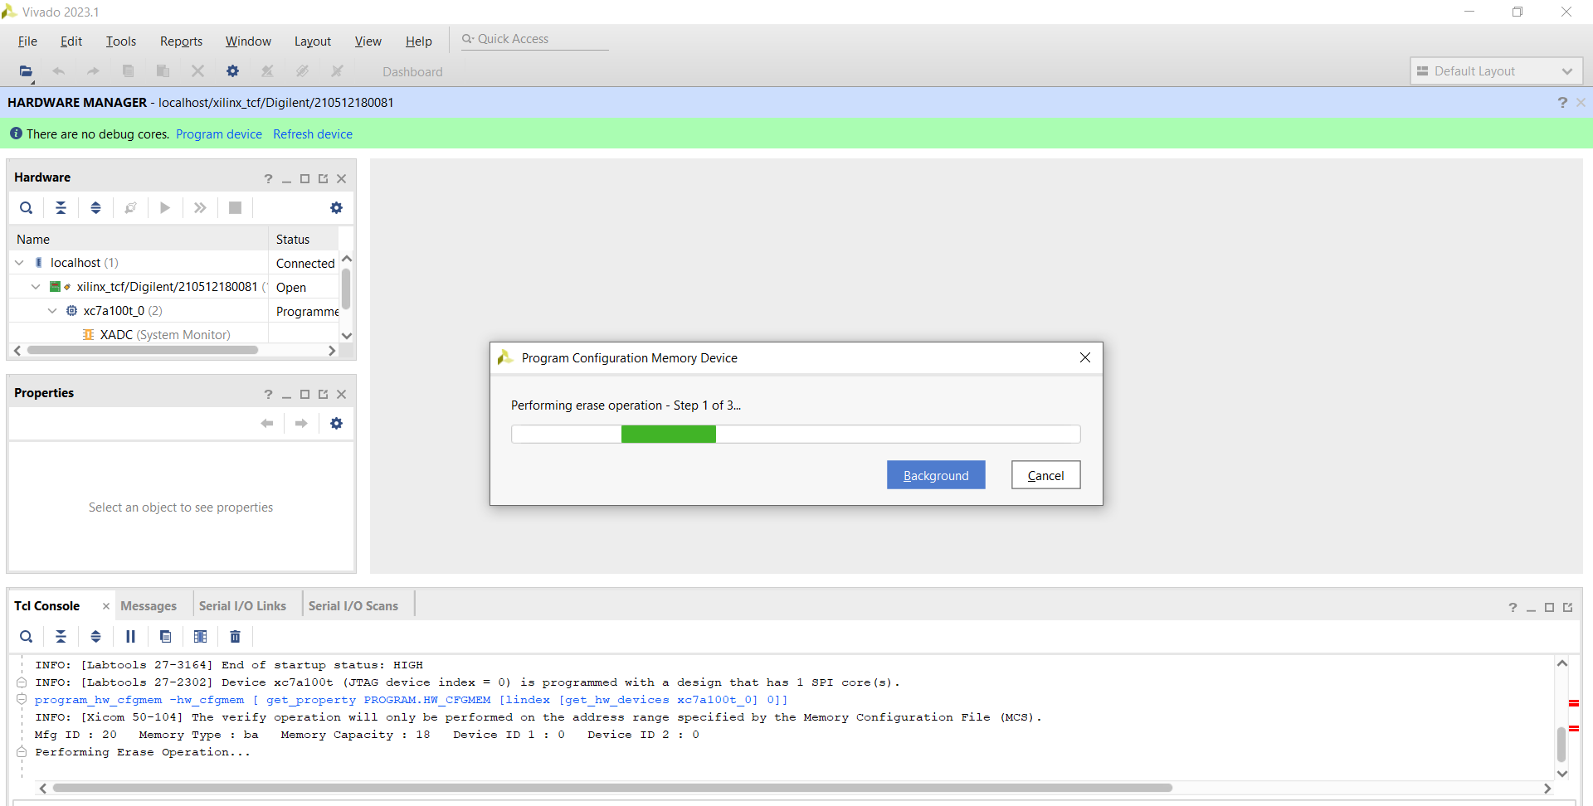
Programming will run and it will alert you when finished

